Slide 1
Database Systems(Fall 2021)Project Campus Eats
Db Group-4
Thanh Phan
MAI LEE
VAISHNAVI MAHESHa
OUCHITHYA BOLLU

Slide 2
Introduction
The project topic is ‘Campus Eats’, it is a food ordering application which will ensure faster and safer mode of food delivery on campuses.
Campus eat can also provide users with the ability to order food for on-demand delivery and earn money at their own hours. It can also provide an alternative for tedious part time jobs.
Food quality can be closely monitored by the University with on-campus food delivery app which in-turn helps in developing a stronger niner nation. Moreover, campus eats can help both university and the students financially.

Slide 3
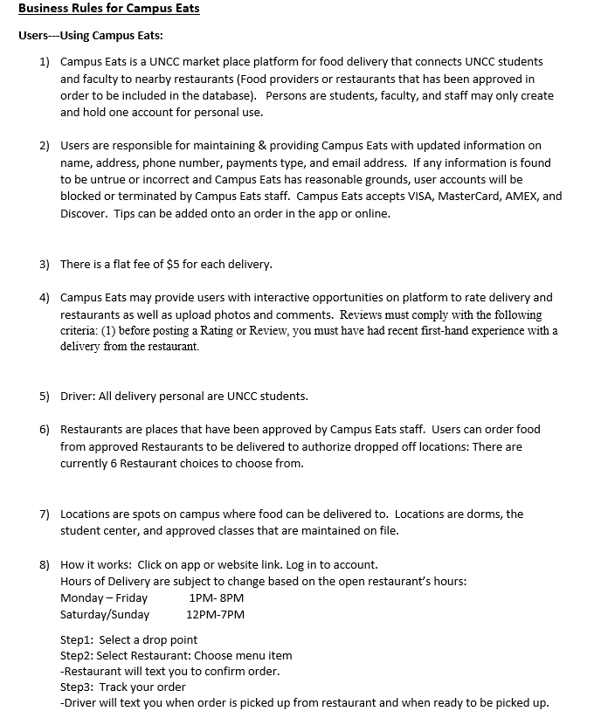
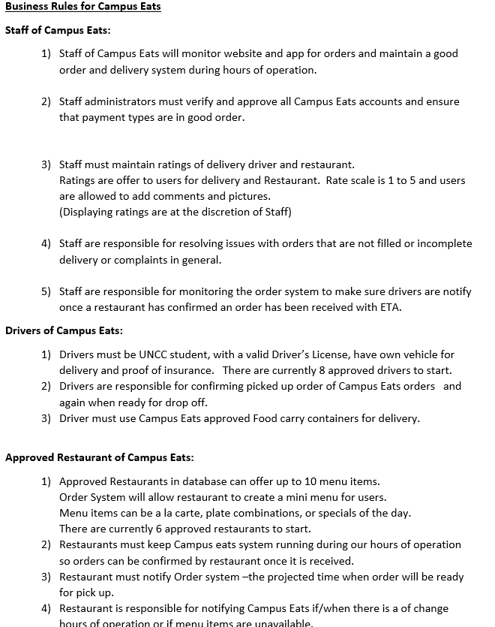
Business Rules for Campus Eats

Slide 4
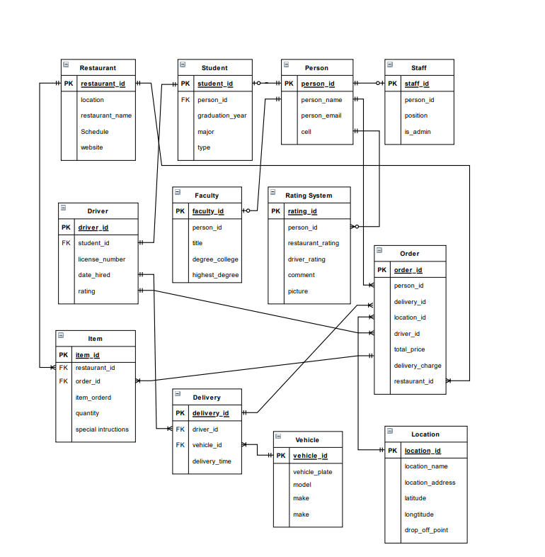
EERD Diagram

Slide 5
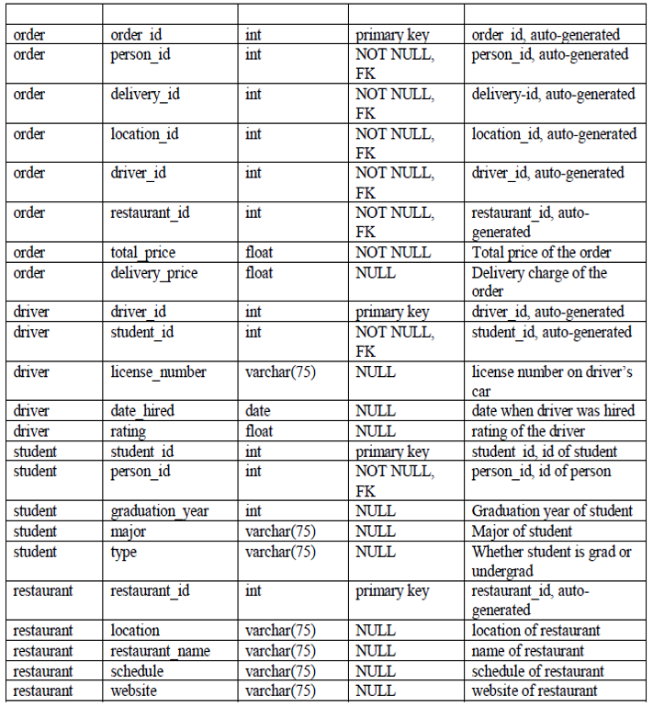
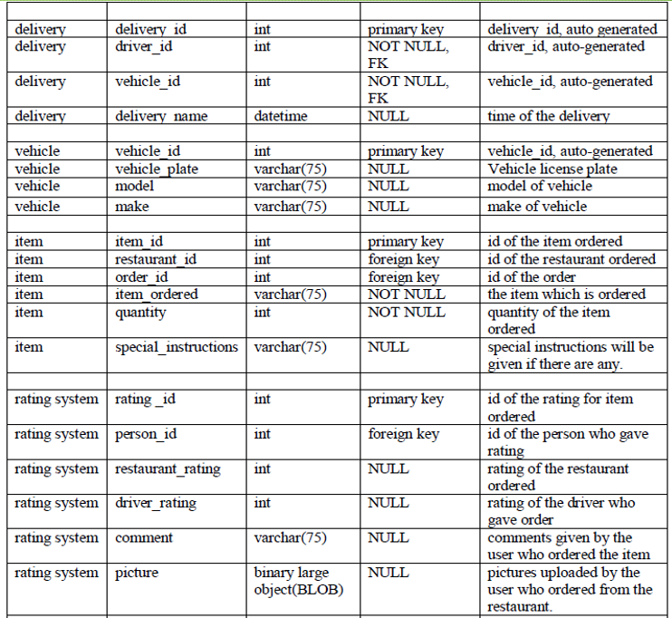
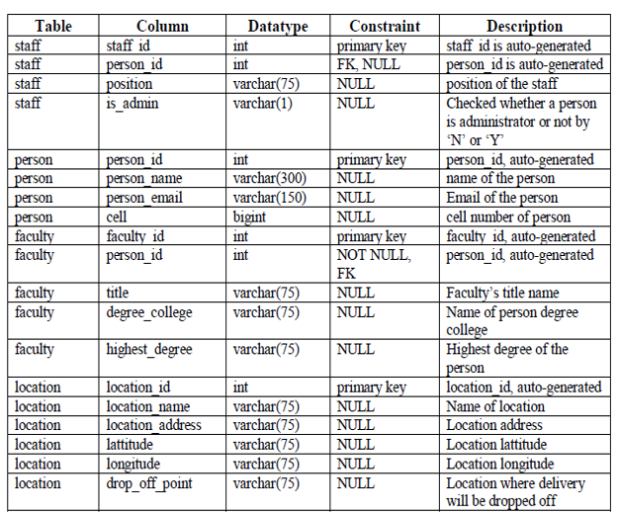
Data Dictionary
The data dictionary in our project shows the relationship between the data and how it relates to each other.
The table gives the information of all the tables and type of data present and relationship between the tables.
The tables helps us to have an overview of what database is composed of.

Slide 6
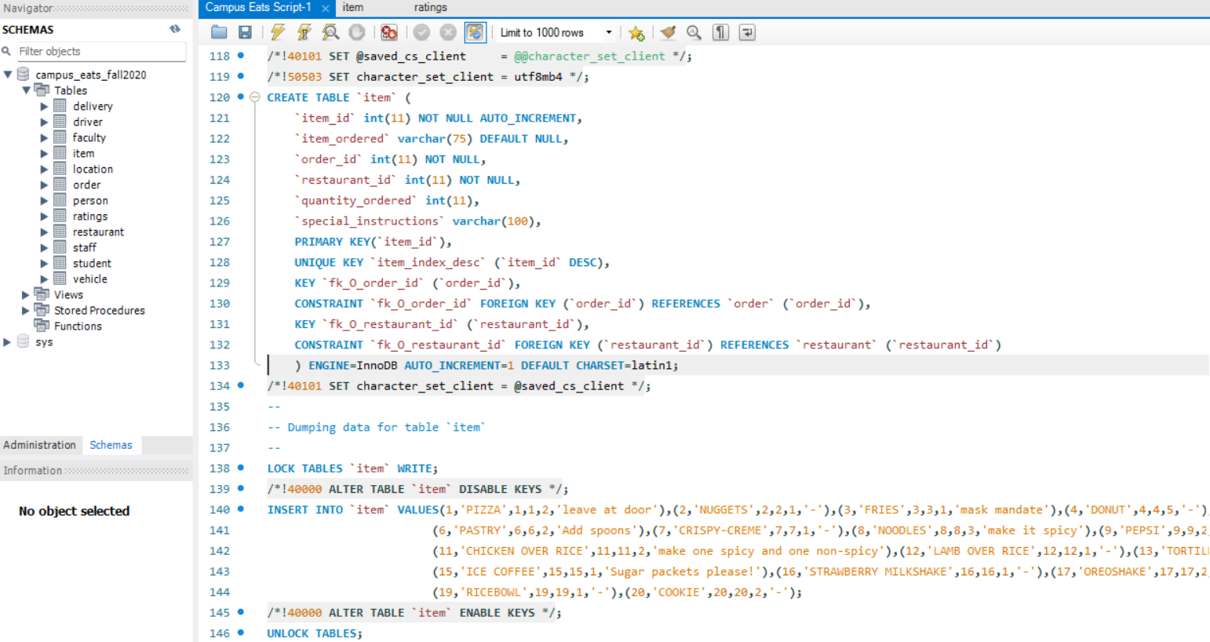
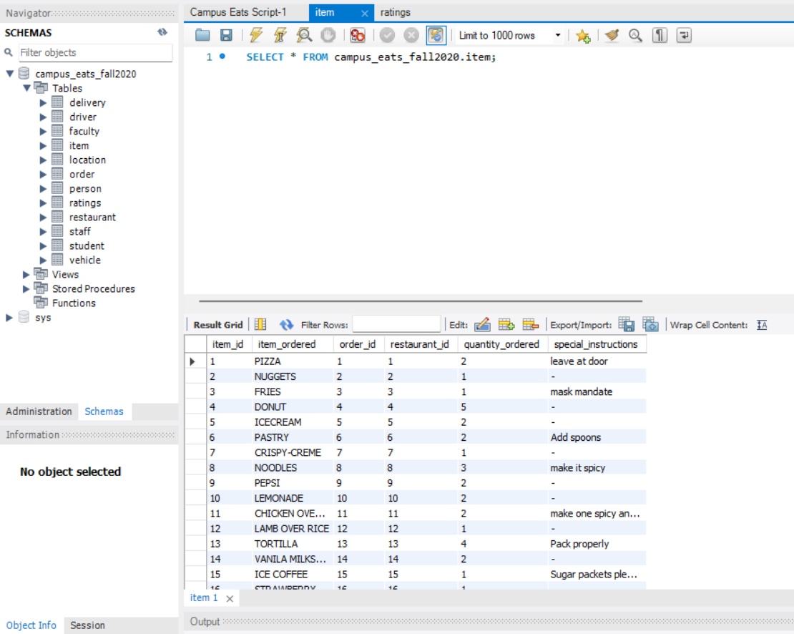
Updating the existing campus eats database
Adding item table to the database.

Slide 7
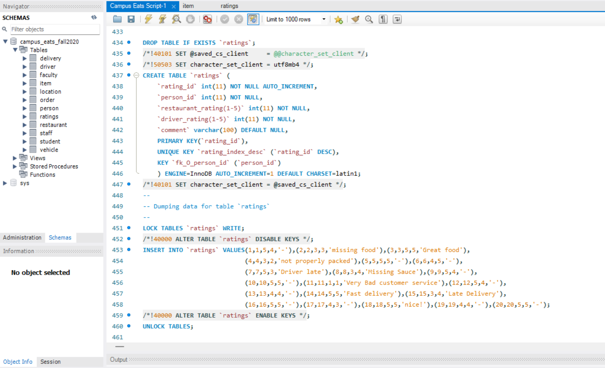
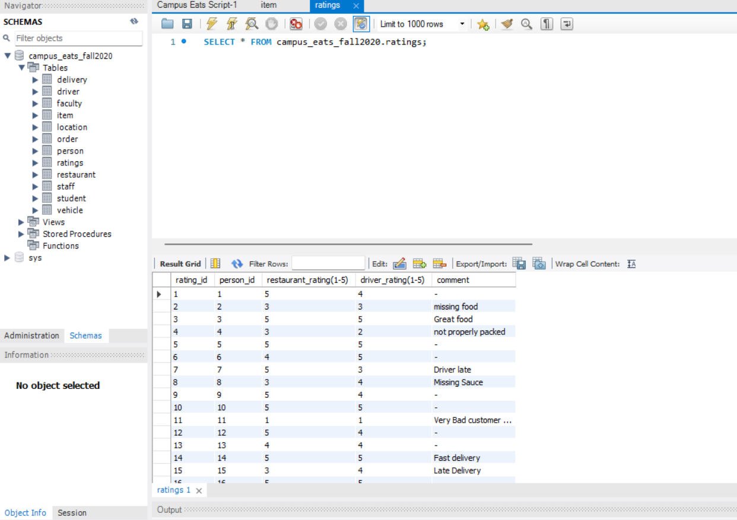
Updating the existing campus eats database(Contd.)
Adding ratings table to the campus eats database.

Slide 8
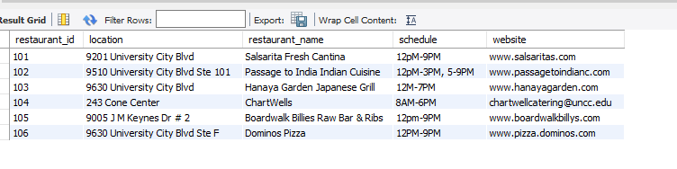





Approved restaurants in Database
Here are some of the restaurants which we tried to add in our database.
We added the restaurant id, location, restaurant website and the timings etc., every field which was necessary to place an order.

Slide 9
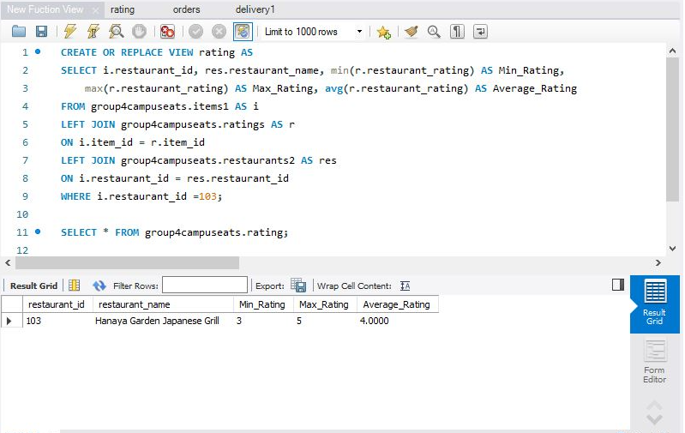
AVG, MIN, MAX operations
Some of the operations like AVG, MIN, MAX are performed on the ratings for the restaurant id as a view.
The query is shown below

Slide 10
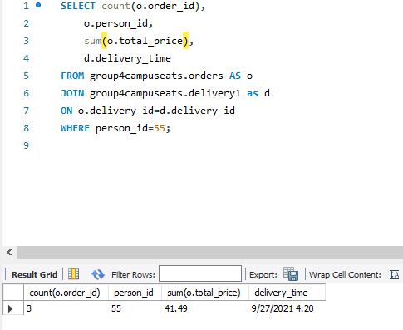
COUNT operation
Count orders when the given person id and date are selected.

Slide 11
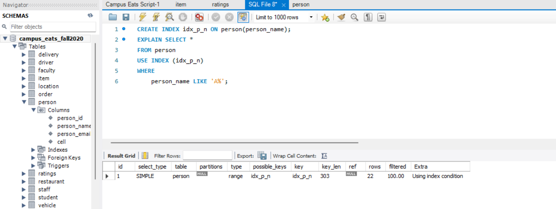
INDEX
We are using index on person name to find person names startin with ‘A’.

Slide 12
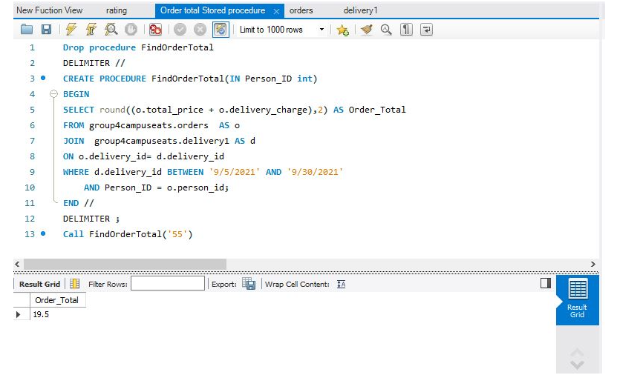
Stored Procedure
Total ordered is listed by a specific person as a stored procedure.

Slide 13
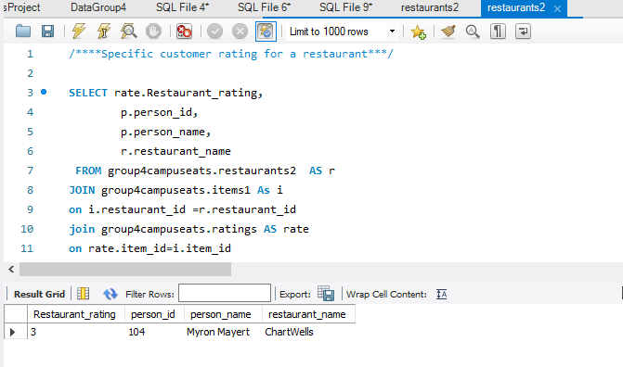
Customer rating for a restaurant

Slide 14
Thank You

